Slide 1
COMP507 IT Project Management Communications Management

Slide 2
Agenda
Why communications?
Determine the number of communication channels
Communications management processes: plan, manage and monitor
PMI communication model, 5 Cs, tailoring and monitoring
Best practice

Slide 3
Recap: Project requirements
Projects have phases.
Project phases are planning, analysis, design, development, testing, and deployment. You can’t have an ad hoc approach to your project. A common theme with our R&D projects
Need a formal PM methodology with clearly identified planning, analysis, design, development, testing, and deployment phases together with tasks for each phase. A PM methodology also helps to decide project roles.
PM methodology- Planning phase, the first phase must be based on PMI.

Slide 4
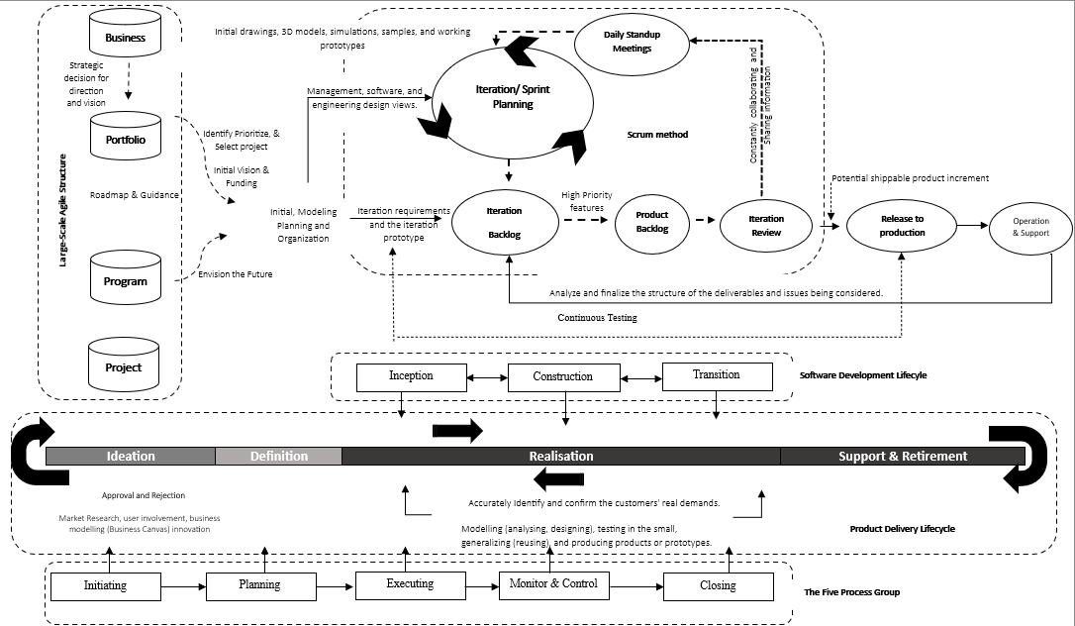
The Product Delivery Lifecyle

Slide 5
Communication complexity
Communication is a major project management problem because many projects struggle or fail when project information is not communicated clearly to stakeholders.
Stakeholders often do not receive the full picture of project goals, progress, risks, issues, and expectations, which creates misunderstanding and misalignment.
Poor communication is a common failure factor. In the Bull Survey of 203 IT and project managers across several UK sectors, poor communications was identified by 40% of respondents as a project failure criterion and ranked third among the causes.
Lack of user input creates communication failure. The Chaos Report showed that one of the top reasons for project failure was lack of user input (12.8%), which suggests weak communication between the project team and users.
Incomplete requirements and specifications also reflect communication breakdown. The Chaos Report identified incomplete requirements and specifications (12.3%) as another top failure reason, showing that project needs were not communicated, clarified, or documented properly.
Project communication is complex because it must work across multiple directions between managers, team members, users, customers, and other stakeholders.

Slide 6
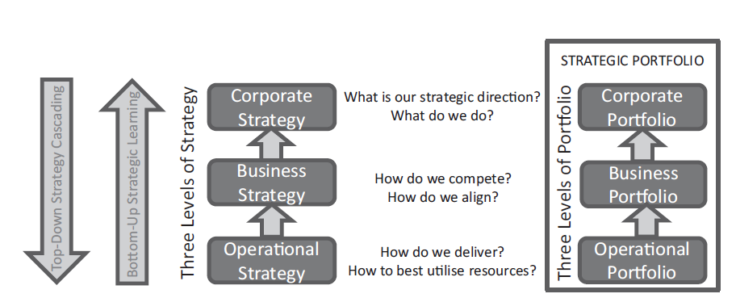
The importance of Communication

Slide 7
Process of communication
The communicator is the originator of the message.
The message we want to convey may consist of thoughts, feelings, or ideas.
The medium, the vehicle or method, used to convey the message, will also colour the message and ultimately influence its effect.
The recipient is the player who “makes or breaks” the communication process.

Slide 8
PMI Communication Model
Encode: sender turns an idea into a message
Transmit: message is sent through a selected medium
Decode: receiver interprets the message
Acknowledge: receiver confirms the message was received
Feedback/response: receiver shows whether meaning was understood
Noise: barriers that distort or block the message

Slide 9
Main roles for communication
The project manager must be a communicator: to upper management, to the project team, and to members outside the project who have an interest in the project's results.
Portfolio managers must be communicators: to business strategy leaders, to program and project layers, and to stakeholders who need visibility of priorities, investment choices, and delivery value.
Program managers must be communicators: to portfolio management, to project managers and cross-team delivery groups, and to stakeholders affected by coordination, dependencies, and readiness.
Operation managers must be communicators: to delivery teams, to support and service teams, and to users and business stakeholders concerned with service performance, incidents, and ongoing product value.
Support manager must be communicators: to operations management, to delivery teams, and to customers and users who provide feedback on product issues and service quality.
C-level executives must be communicators: to business strategy and portfolio management, to operations and support teams, and to customers and stakeholders affected by withdrawal, replacement, or transition plans.

Slide 10
Dimensions of Project Communication
Internal: communication within the project and organisation
External: customers, vendors, regulators, public groups
Formal: reports, meetings, presentations, official documents
Informal: quick discussions, email, chat, social communication
Upward, downward and horizontal communication
Official / unofficial and written / oral / non-verbal communication

Slide 11
Effective Project Communication: The 5 Cs
Correct: accurate facts, grammar, names and terminology
Concise: remove unnecessary words and repeated information
Clear: make the purpose and expected action obvious
Coherent: organise ideas in a logical order
Controlled: structure the message so important points are easy to follow

Slide 12
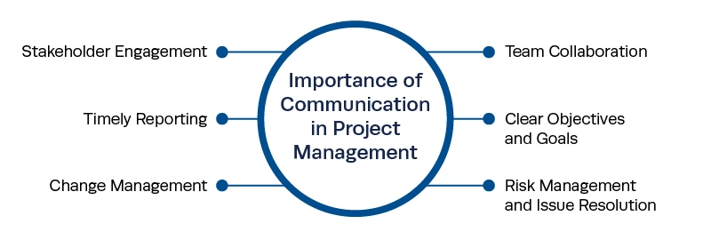
Communication- critical for project success
Source- Institute Project Management

Slide 13
Project Communication Management: What is it all about?
When does project communication happen?
Project kick-off meeting- when and why?
Team meetings- when and how frequent? The daily standup or weekly or monthly meetings?
Client meetings (PO & PM meeting)- when and how frequently?
Status update meetings- when and how often?
Milestone meetings to discuss progress and project risks and determine a path forward- when and how?
Review meetings to present and get acceptance on project deliverables periodically- when and how often?
Lessons learned meetings or retrospectives. Presentations for clients, customers, or other stakeholders- when and how often
Executive updates, written briefs and presentations- when and how often

Slide 14
Communication- a critical knowledge area
Projects require a significant level of communication
Several important concepts can help
Focus on stakeholder and team (group) and individual communication needs
Use formal and informal methods for communicating
Many people prefer informal communications
Distribute important information in an effective and timely manner
E.g., agile projects have daily meetings (daily stand-up meetings) to make sure everyone is on the same page
Determine the number of communication channels
Simplify communication complexity by reducing communication channels

Slide 15
Communication- a critical knowledge area
Projects require a significant level of communication
Several important concepts can help
Focus on stakeholder and team (group) and individual communication needs
Use formal and informal methods for communicating
Many people prefer informal communications
Distribute important information in an effective and timely manner
E.g., agile projects have daily meetings (daily stand-up meetings) to make sure everyone is on the same page
Determine the number of communication channels
Simplify communication complexity by reducing communication channels

Slide 16
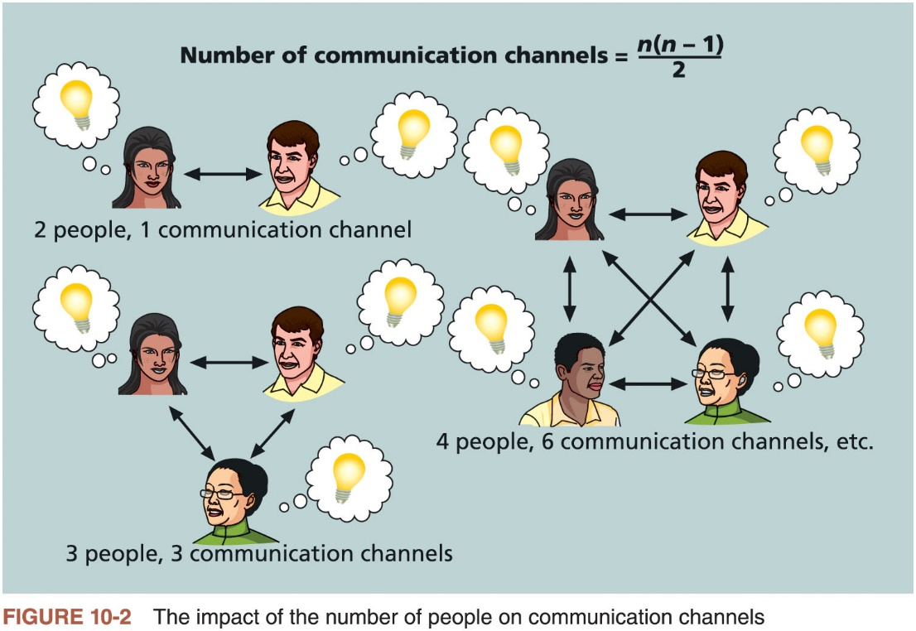
Determine the number of communication channels

Slide 17
Forms of Project Communication
Interpersonal: one person communicating directly with another person
Small-group: communication within a small team or working group
Public: one person communicating to a larger project audience
Mass: information distributed to a large audience with limited direct interaction
Network and social: many-to-many communication through digital or social platforms
Main point: communication method and audience setting are different decisions

Slide 18
Communication Strategy, Plan and Project Communications
Communication strategy: the overall approach for effective stakeholder communication
Communications management plan: how communication will be planned, structured, implemented and monitored
Project communications: the actual reports, presentations, meeting minutes, updates and dashboards
Main point: strategy decides the approach; the plan organises the work; communications deliver the information

Slide 19
Main processes in project communications management
Planning communications management
Executing the communication plan to managing communications
Monitoring communications

Slide 20
Communications management plan
Communications management plan contents
Stakeholder communications requirements
Information to be communicated, including format, content, and level of detail
Who will receive the information and who will produce it
Suggested methods or technologies for conveying the information
Frequency of communication
Escalation procedures for resolving issues
Revision procedures for updating the communications management plan
A glossary of common terminology

Slide 21
Stakeholder communications analysis-
Communication analysis is done based on the stakeholder register and included in the communication plan. You must complete this for your assignment 1 Part 2 based on your stakeholder register.
Stakeholders | Communication document (Type) | Document Format | Contact Person | Due & frequency
Product manager (lecturer) | Assignment1- part 1 & Part 2- uploaded on canvas Meeting Agenda items (meeting)-email or face to face | Hard copy (use assignment and PMI templates) Meetings (use PMI template) document | Project manager | Part 1 due date Part 2 due date Meetings as required (weekly lecture and labs)
PO (TAs) | Assignment1- part 1 & Part 2 Meeting Agenda items (meetings) | Hard copy (use assignment and PMI templates) Meeting (use PMI template) document | Project manager Team | Part 1 due date Part 2 due date Meetings (weekly labs)
BCIS programme leader | Monthly status Reports- email | Status (template) report |  | End of the month
HOD | Monthly status reports- email | Status (template) report |  | End of the month
HOS | Monthly status report- email | Status (template) report |  | End of the month
School Manager | Monthly status report- email | Status (template) report |  | End of the month
Team members | ???

Slide 22
Communication Should Change Stakeholder Engagement
Current engagement: how the stakeholder is involved or behaving now
Desired engagement: the level of involvement needed for project success
Engagement gap: the difference between current and desired engagement
Communication response: targeted communication used to close the gap
Main point: communication is used to increase support and reduce resistance

Slide 23
Activity One: Stakeholder communications plan
A university is developing a Student Mental Health Support App before the next academic year. The Project Sponsor wants quick visibility of progress, risks, and delivery. The Counselling Team needs to clarify how the app should support real counselling workflows. The IT Development Team needs regularly updated technical information. The Cybersecurity and Privacy Office requires evidence before approving sensitive data decisions. The Student Association wants student feedback considered before design decisions are finalised. The University Executive Committee only wants major milestone and budget information. Students will eventually need simple information about launch and use.
For each stakeholder, identify the most appropriate:
Communication document type
Document format

Slide 24
Activity One: Stakeholder communications plan
Stakeholders | Communication document (Type) | Document Format

Slide 25
Tailoring Communication to the Stakeholder
Communication style: preferred method, format and level of detail
Power and influence: formal authority and informal influence
Culture: language, hierarchy and norms that shape interpretation
Information preference: high-level summary or detailed evidence
Engagement need: normal updates or additional targeted communication
Main point: do not communicate with every stakeholder in exactly the same way

Slide 26
Managing Communications
Managing communications is a large part of team’s job
Getting project information to the right people at the right time and in a useful format is just as important as developing the information in the first place
Important considerations
Use of technology
Appropriate methods and media to use
Performance reporting

Slide 27
Tools using technologies-Virtuality
Rely on telecom networks: telephones, cell phones, texting
Reply on Internet: E-mail, instant messaging, twitter, websites, wiki, virtual conference…
Exercise: classify the above tools into three methods: interactive, push, or pull

Slide 28
Activity Two: Managing Communication
A university is upgrading its library room booking system before the next semester. The Project Sponsor wants brief progress updates but expects major risks to be raised immediately. The IT Development Team needs detailed and reliable information about requirements, issues, and tasks. Library Staff need to understand how the new booking process will work without receiving unnecessary technical detail. Student Representatives want opportunities to discuss new features and provide usability feedback. The Software Vendor needs regular technical and scheduling coordination. The University Executive only requires information at important project points. Students need simple information when the system becomes available or booking access changes.
Task
For each stakeholder, determine the most appropriate:
Communication channel
Frequency of communication

Slide 29
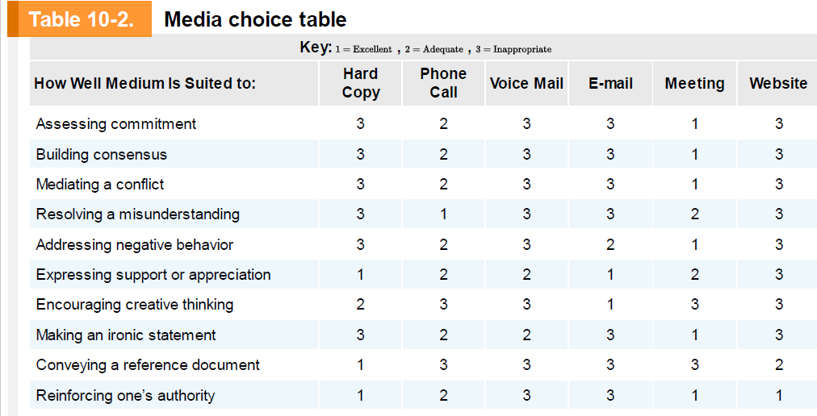
Choice of media

Slide 30
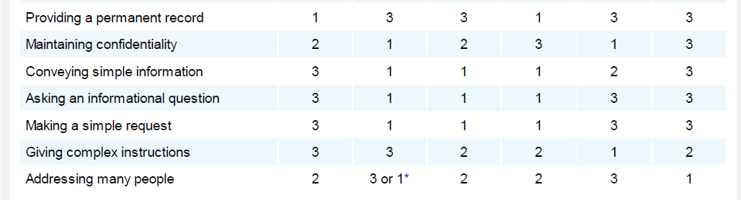
Choice of media

Slide 31
Reporting Performance
Performance reporting keeps stakeholders informed about how resources are being used to achieve project objectives
Progress reports* describe what the project team has accomplished during a certain period of time
Status* reports describe where the project stands at a specific point in time
Forecasts predict future project status and progress based on past information and trends
*Both important in R&D Papers.

Slide 32
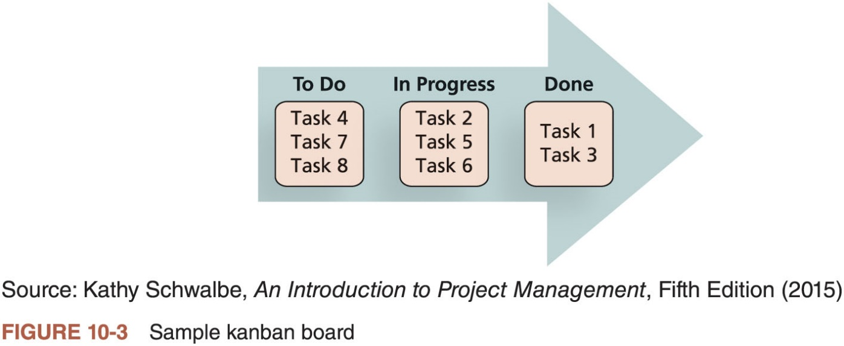
Best Practice
One of the main features of kanban is visualizing workflow, which is often done by using kanban boards
People using kanban boards can tailor the concepts to meet their needs

Slide 33
Project Communication Skills
Active listening: check meaning before responding
Feedback: confirm whether the message was understood
Non-verbal communication: tone, body language and timing matter
Presentation skills: translate project information for the audience
Cultural awareness: adapt communication across backgrounds and locations
Conflict and meeting management: keep discussion focused and useful

Slide 34
Communication in Agile and Adaptive Projects
Use frequent checkpoints to keep understanding current
Make work visible through boards, backlogs, dashboards and reviews
Support fast feedback from customers, users and team members
Reduce delays by using direct communication where possible
Adapt communication as requirements, priorities and risks change
Keep stakeholders close to the evolving product, not only final delivery

Slide 35
Running Effective Meetings
Guidelines to help improve time spent at meetings
Determine if a meeting can be avoided
Define the purpose and intended outcome of the meeting
Determine who should attend the meeting
Provide an agenda to participants before the meeting
Prepare handouts and visual aids, and make logistical arrangements ahead of time
Run the meeting professionally
Set the ground rules for the meeting
Build relationships

Slide 36
Activity Three: Online Course Registration System Project
A university is implementing a new online course registration system before the next semester. The Project Sponsor needs regular visibility of status, budget, and major risks. The IT Development Team needs continuous coordination on tasks, defects, and technical decisions. Registrar’s Office staff need to review how the new enrolment workflow will operate. Student Representatives want opportunities to discuss usability and provide feedback. The Software Vendor must exchange technical documents and integration information. The University Executive only requires milestone-level information. Students need simple information about launch and system use.
Task
For each stakeholder, identify the most appropriate:
Communication tool
Communication type: Interactive, Push, or Pull

Slide 37
Project Communication Skills
Active listening: check meaning before responding
Feedback: confirm whether the message was understood
Non-verbal communication: tone, body language and timing matter
Presentation skills: translate project information for the audience
Cultural awareness: adapt communication across backgrounds and locations
Conflict and meeting management: keep discussion focused and useful

Slide 38
Communication in Agile and Adaptive Projects
Use frequent checkpoints to keep understanding current
Make work visible through boards, backlogs, dashboards and reviews
Support fast feedback from customers, users and team members
Reduce delays by using direct communication where possible
Adapt communication as requirements, priorities and risks change
Keep stakeholders close to the evolving product, not only final delivery

Slide 39
Running Effective Meetings
Guidelines to help improve time spent at meetings
Determine if a meeting can be avoided
Define the purpose and intended outcome of the meeting
Determine who should attend the meeting
Provide an agenda to participants before the meeting
Prepare handouts and visual aids, and make logistical arrangements ahead of time
Run the meeting professionally
Set the ground rules for the meeting
Build relationships

Slide 40
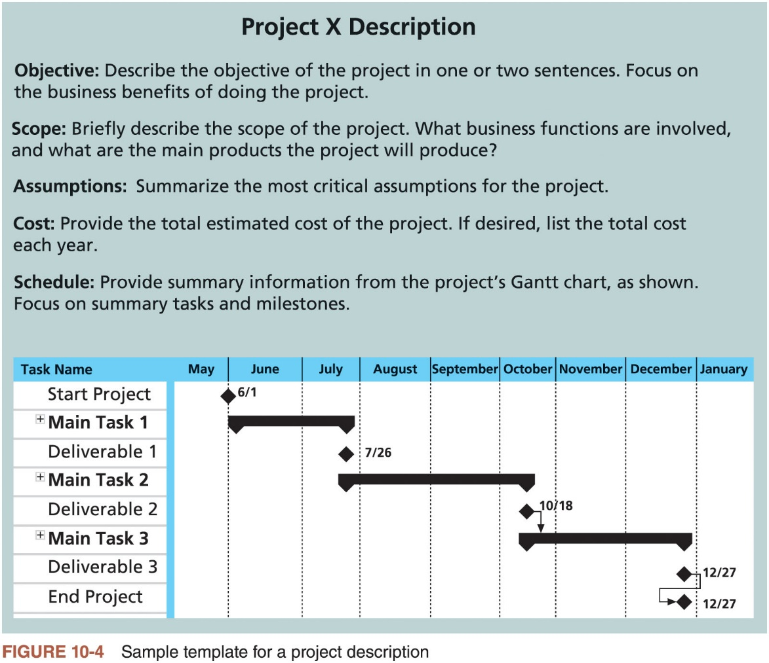
Using Templates for Project Communications

Slide 41
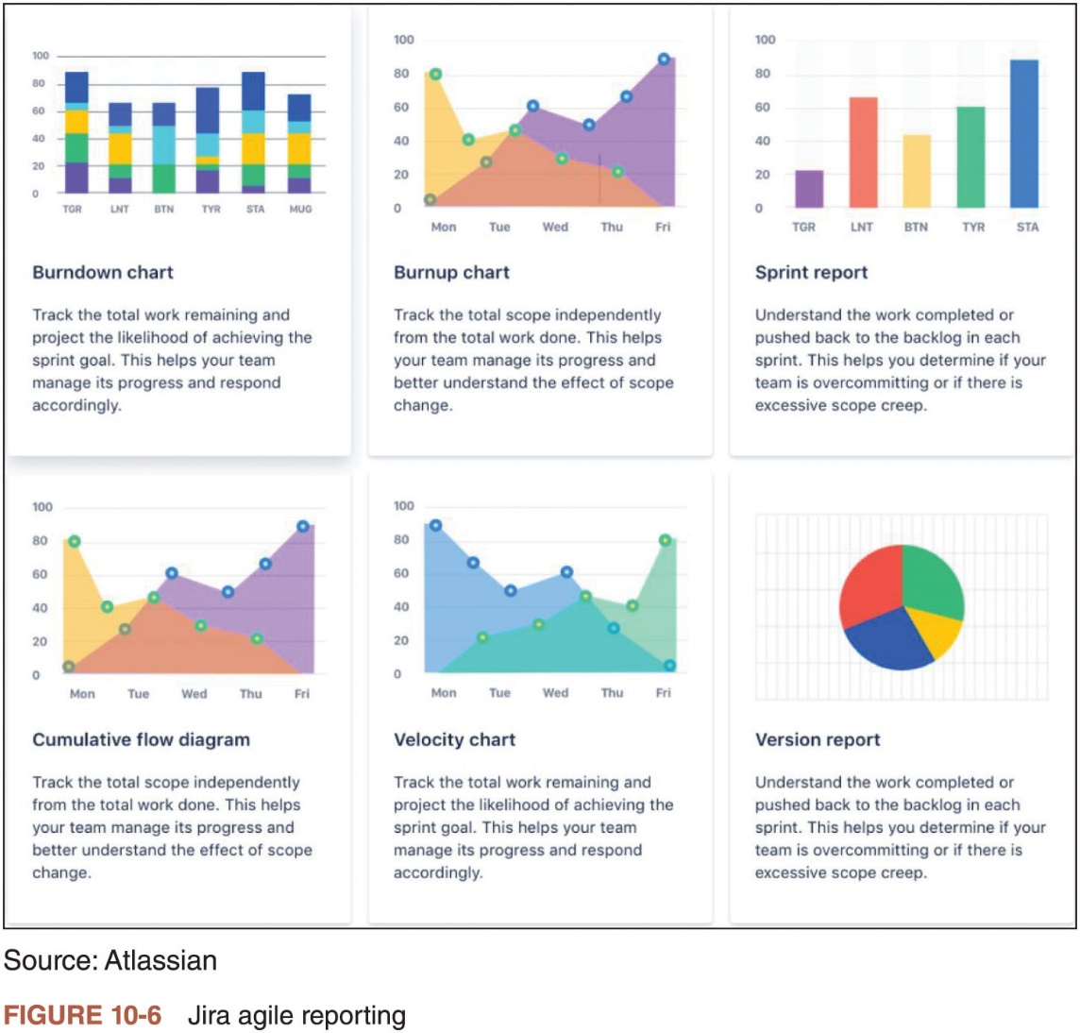
Dashboards for Project Communications

Slide 42
Monitoring Communication Effectiveness
Right message: did stakeholders receive what they needed?
Right audience: did it reach the correct people?
Right channel: was the method appropriate?
Right time: was it early enough to support action?
Right understanding: did the receiver interpret it correctly?
Use feedback, issue logs, surveys, dashboards and lessons learned

Slide 43
Tailoring Project Communications
Stakeholders: different people need different levels of detail
Location: colocated and virtual teams need different approaches
Technology: select tools that fit the team and organisation
Language: avoid terminology that stakeholders may not understand
Knowledge management: make information easy to store, find and reuse
One communication approach will not suit every project

Slide 44
R&D/Project Communications Planning
Identify critical stakeholders (team, client, mentor), frequency of meetings and type of communication channel best suited
Follow the method tasks and practices/techniques
What tools? What reporting? When to escalate?

Slide 45
Homework
Before next week’s class Chapter 8 Quality Management from Information Technology Project Management (2019) by Kathy Schwalbe

Slide 46
Q&A

